Slide 1

Basic Details of the Team and Problem Statement
Ministry/Organization Name/Student Innovation:
Government of Punjab
PS Code: 1305 Problem Statement Title: The Employment Department at present has a digital platform www.pgrkam.com and its mobile application to provide almost all services offered to job seekers and employers through digital means. The portal has multiple modules like private sector jobs, government jobs, self-employment avenues, foreign jobs, foreign study, counseling, guidance, induction into armed forces, job meals, etc. Currently, when a user visits the portal/app, there is no hand-holding mechanism to help the user get to the part of the digital platform which will resolve his queries. The user is required to navigate across multiple modules on the portal/ app to search for answers.
Team Name: Growth Guards Team Leader Name: Uzzma Saiyed Institute Code (AISHE): C-58356 Institute Name: Faculty of Computer Applications and IT
Theme Name: Smart Automation

Slide 2

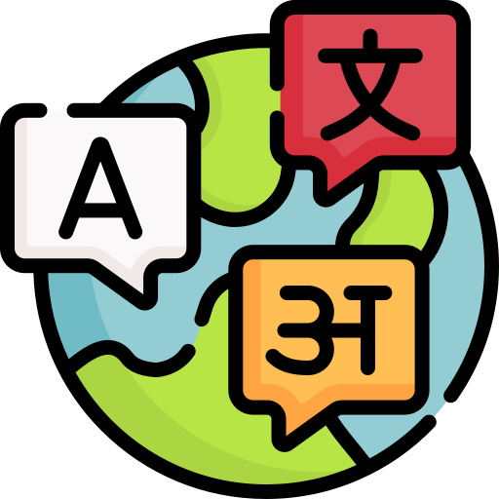
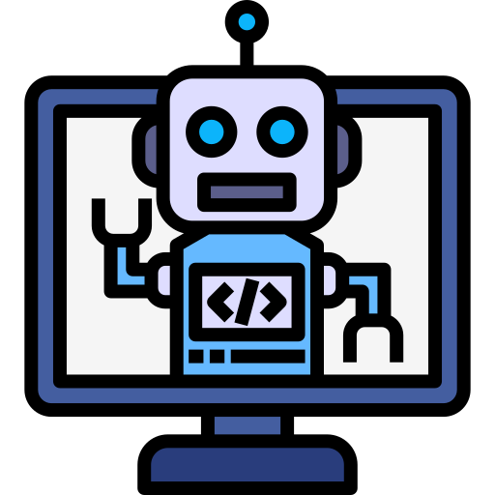



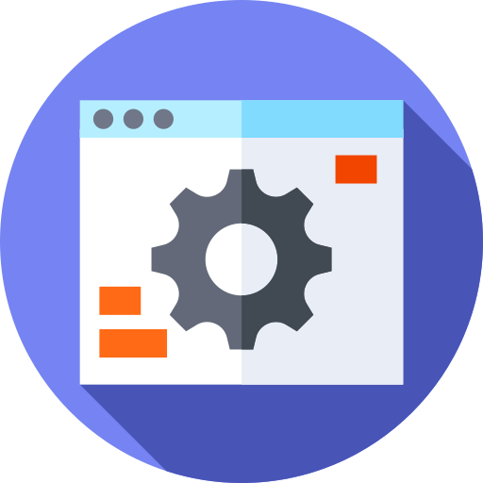




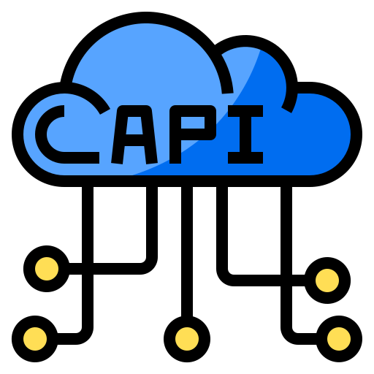



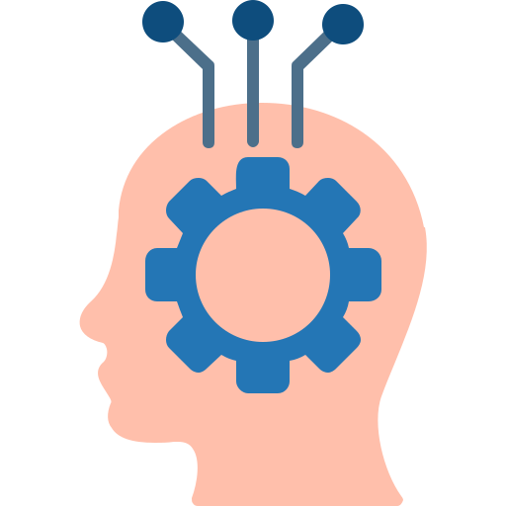

Idea/Approach Details
IDEA DESCRIPTION:
The user will write queries to the chatbot. Chatbot can help to find information and services according to the queries, more quickly and easily. Users need no longer to navigate through multiple modules on the platform to find what they are looking for. Users can interact with the chatbot to discover job recommendation, skill development or foreign counselling.
PROCESS FLOW CHART
Open the chatbot
Multilingual greeting
TECHNOLOGY STACK
Query Solution
Chatbot asks how it can assist
No
Front-End
Tech Stack
Middleware
Tech Stack
Back-End
Tech Stack
Database
Servers
User enters query (text or voice)
yes
Continues
conversation
Chatbot understands query
Responds
Flutter
Rest API
Python
Firebase+ MySQL
Apache

Slide 3
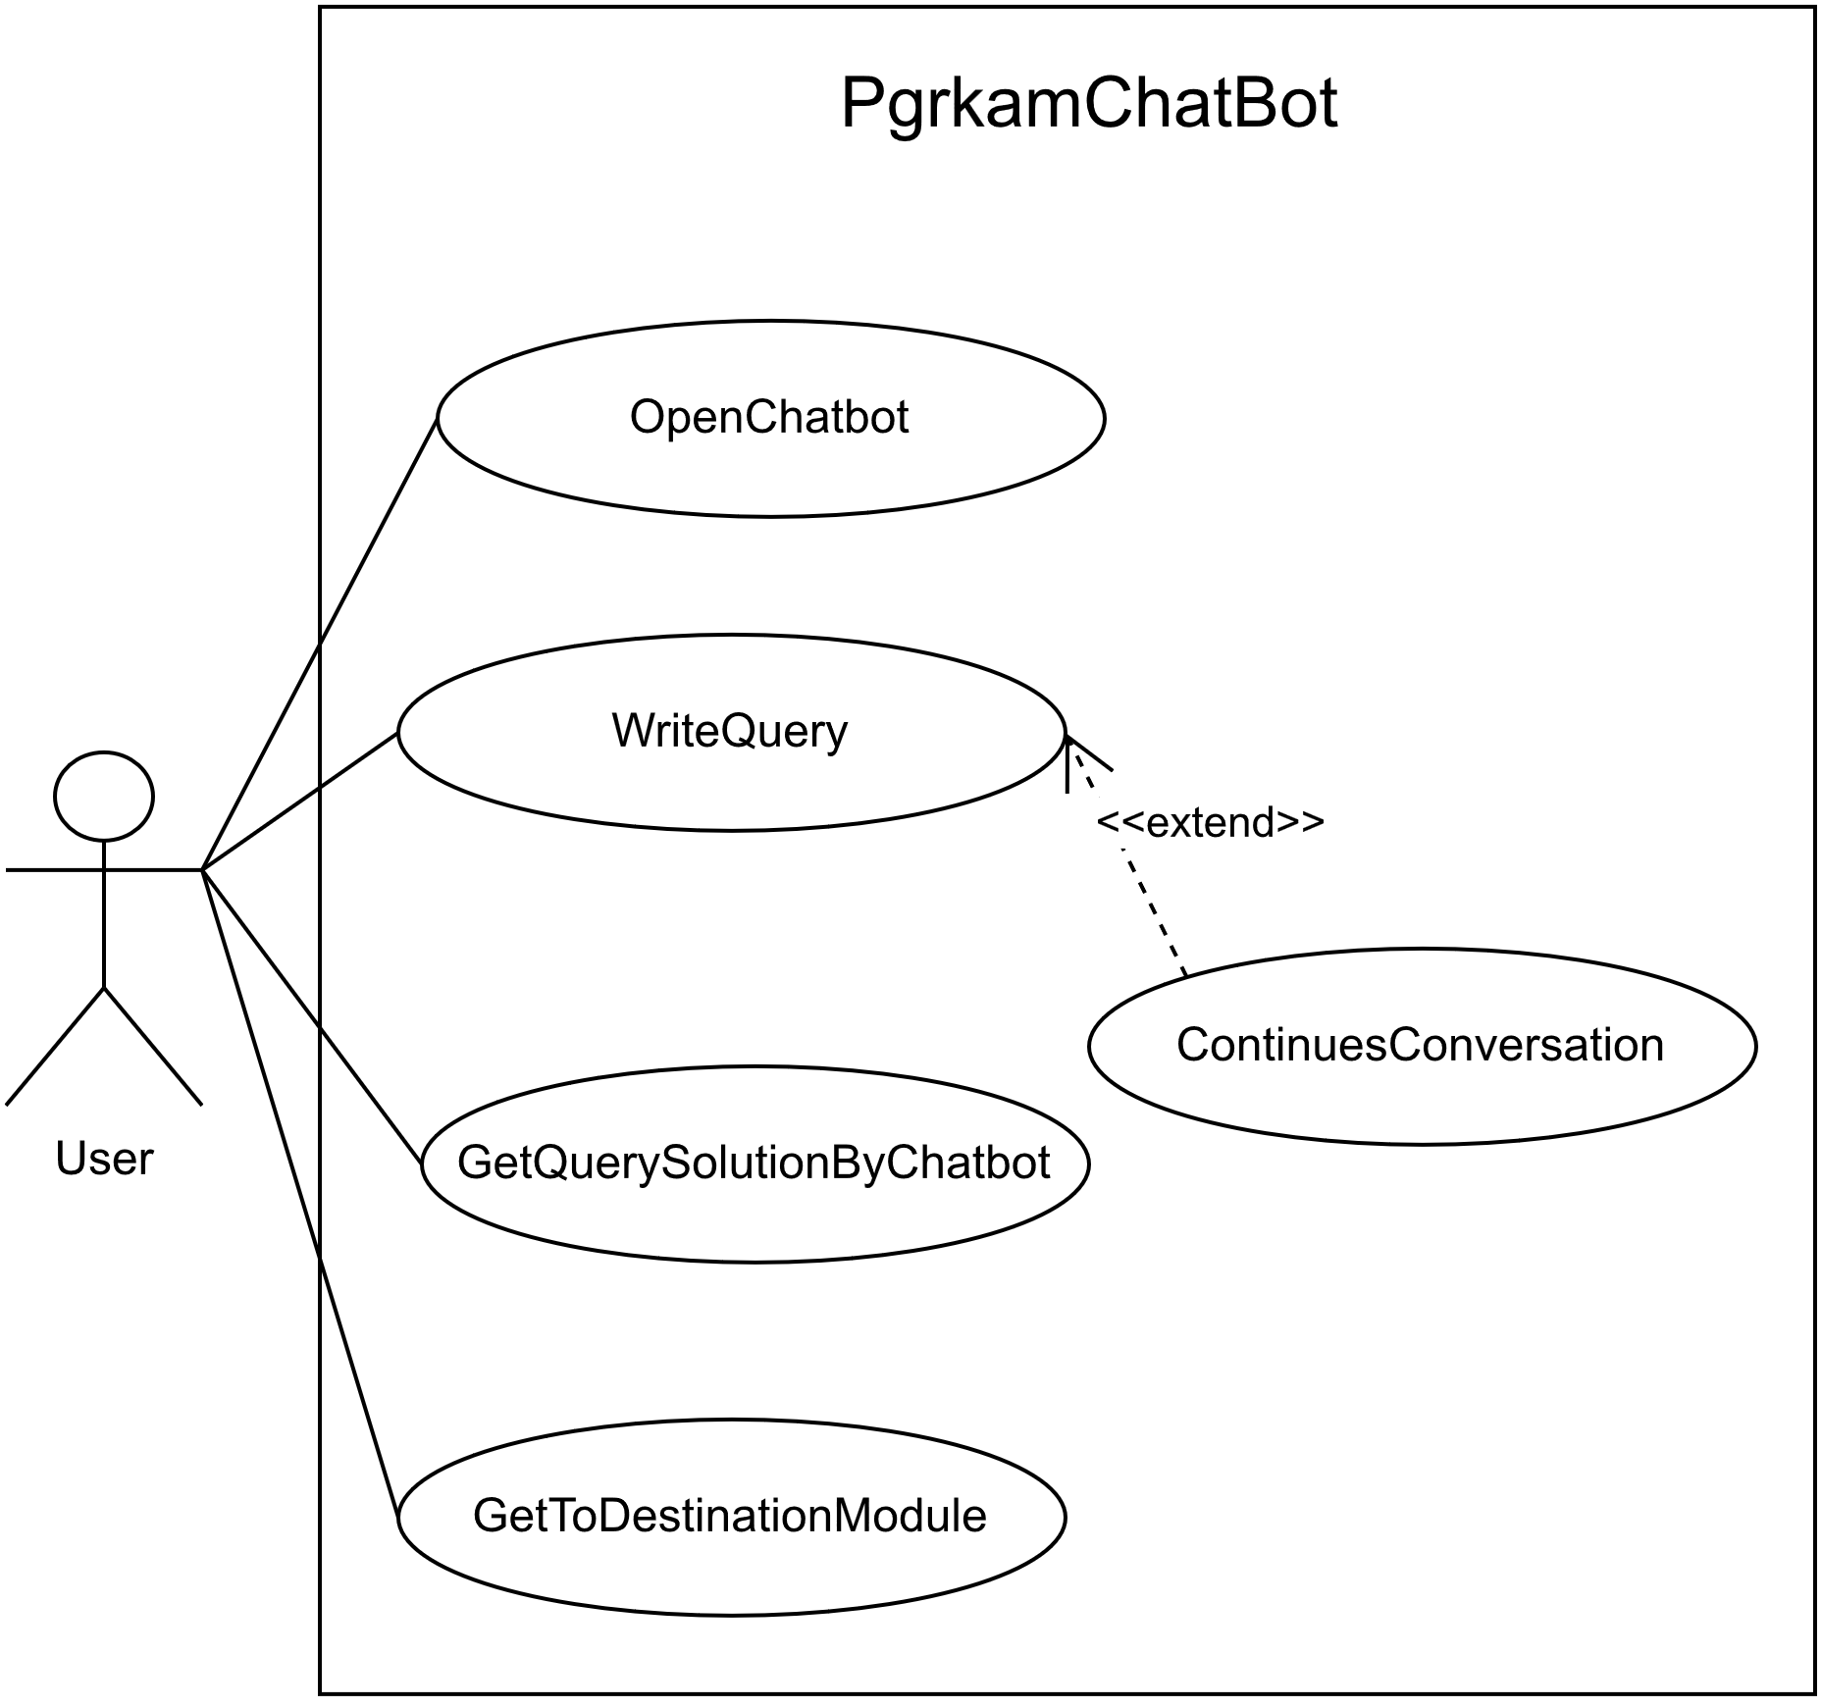



Idea/Approach Details
Use Case:
SHOW STOPPER
Dependencies
With this chatbot, user can easily navigate the modules. When user is new to application, this chatbot gives perfect direction for his or her destination module.
The chatbot also helps to discover job , skill development or foreign counselling according to user preferences.
The chatbot will need large amount of data such as Multilingual language model , user conversation.
The application will allow the chatbot to help users navigate to the correct part of the platform to find the information and services they need.
Training and deploying Multilingual language model requires a lot of computing power.
Query Solution
Chatbot solution
User apply solution in pgrkam application
Destination Module
Happy User

Slide 4
Team Member Details
Team Leader Name: UZZMA SAIYED
Msc. Stream (ECE, CSE etc): Year (I,II,III,IV): I
Team Member 1 Name: SMIT JOSHI
Msc. Stream (ECE, CSE etc): Year (I,II,III,IV): I
Team Member 2 Name: TEJASV MODI
Msc. Stream (ECE, CSE etc): Year (I,II,III,IV): I.
Team Member 3 Name: KHUSHI LODHA
Msc. Stream (ECE, CSE etc): Year (I,II,III,IV): I
Team Member 4 Name: DIGVIJAY JAKHANIYA
Msc. Stream (ECE, CSE etc): Year (I,II,III,IV): I
Team Member 5 Name: VISHVA RAVAL
Msc. Stream (ECE, CSE etc): Year (I,II,III,IV): I
Team Mentor 1 Name: Type Your Name Here
Category (Academic/Industry): Expertise (AI/ML/Blockchain etc): Domain Experience (in years):
Team Mentor 2 Name: Type Your Name Here
Category (Academic/Industry): Expertise (AI/ML/Blockchain etc): Domain Experience (in years):

